Slide 1
ONPA
2022
Best Ad Ideas Contest

Slide 2
Best Advertising Headline
Ad Group A-D
3rd Place
Keizertimes

Slide 3
Best Advertising Headline
Ad Group A-D
2nd Place
Astoria Daily Astorian

Slide 4
Best Advertising Headline
Ad Group A-D
1st Place
Creswell Chronicle

Slide 5
Best Black & White Ad
Ad Group A-D
3rd Place
Keizertimes

Slide 6
Best Black & White Ad
Ad Group A-D
2nd Place
Keizertimes

Slide 7
Best Black & White Ad
Ad Group A-D
1st Place
Creswell Chronicle

Slide 8
Best Institutional Section
Ad Group D
3rd Place
The New Era

Slide 9
Best Institutional Section
Ad Group D
2nd Place
The New Era

Slide 10
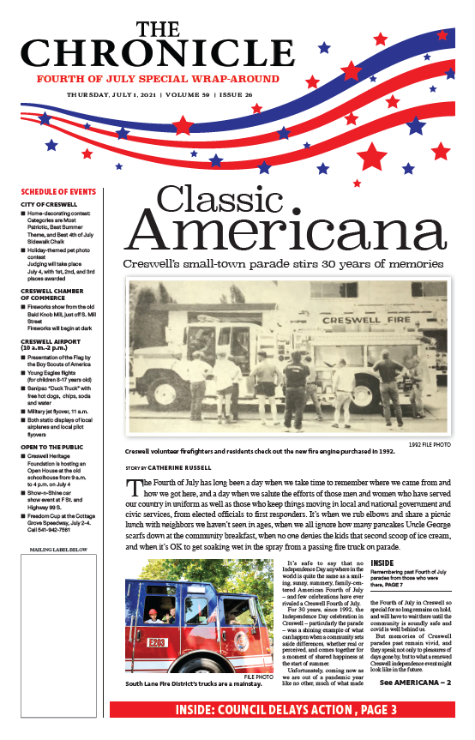
Best Institutional Section
Ad Group D
1st Place
Creswell Chronicle

Slide 11
Best Institutional Section
Ad Group B-C
3rd Place
Astoria Daily Astorian

Slide 12
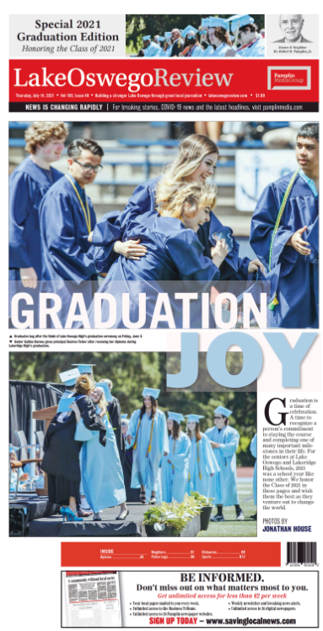
Best Institutional Section
Ad Group B-C
2nd Place
Lake Oswego Review

Slide 13
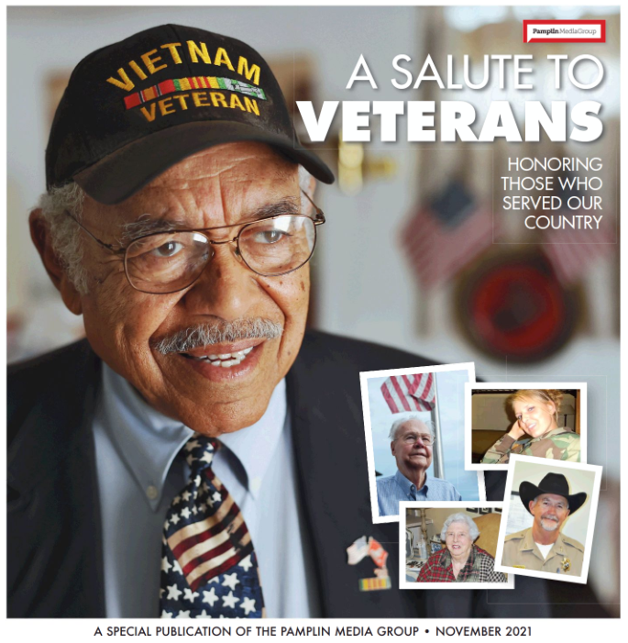
Best Institutional Section
Ad Group B-C
1st Place
Lake Oswego Review

Slide 14
Best Institutional Section
Ad Group A
3rd Place
Bend Bulletin

Slide 15
Best Institutional Section
Ad Group A
2nd Place
Bend Bulletin

Slide 16
Best Institutional Section
Ad Group A
1st Place
Bend Bulletin

Slide 17
Best Institutional-Image Ad
Ad Group D
3rd Place
Malheur Enterprise

Slide 18
Best Institutional-Image Ad
Ad Group D
2nd Place
The New Era

Slide 19
Best Institutional-Image Ad
Ad Group D
1st Place
Creswell Chronicle

Slide 20
Best Institutional-Image Ad
Ad Group C
3rd Place
Keizertimes

Slide 21
Best Institutional-Image Ad
Ad Group C
2nd Place
Keizertimes

Slide 22
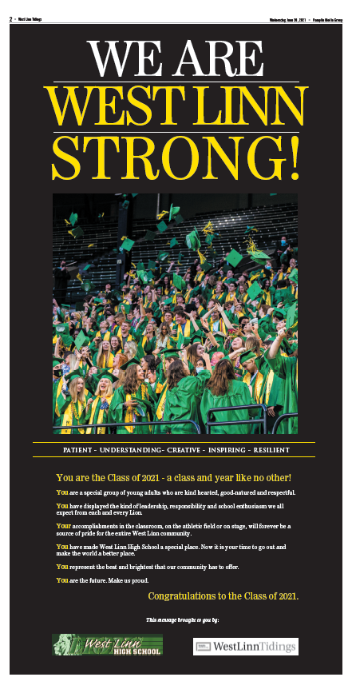
Best Institutional-Image Ad
Ad Group C
1st Place
West Linn Tidings

Slide 23
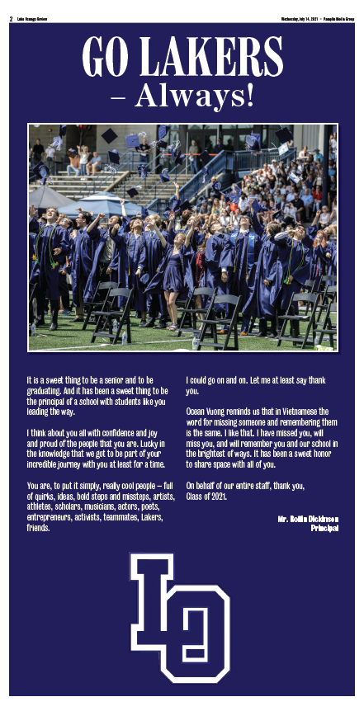
Best Institutional-Image Ad
Ad Group A-B
3rd Place
Lake Oswego Reviewll

Slide 24
Best Institutional-Image Ad
Ad Group A-B
2nd Place
Columbia Gorge News

Slide 25
Best Institutional-Image Ad
Ad Group A-B
1st Place
Lake Oswego Review

Slide 26
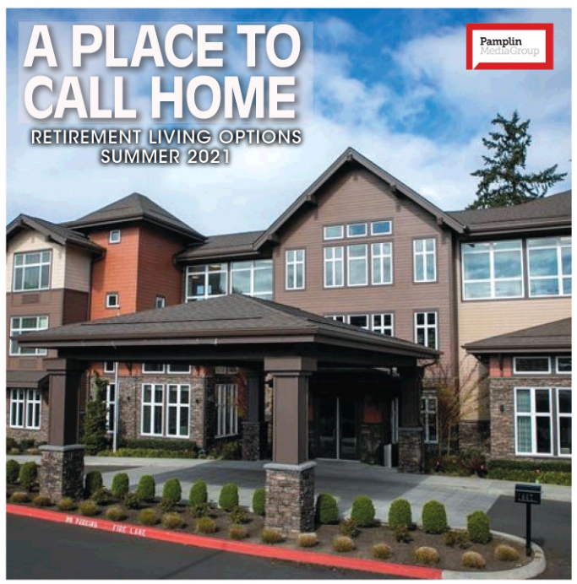
Best Merchandising Section
Ad Group A-D
3rd Place
Lake Oswego Review

Slide 27
Best Merchandising Section
Ad Group A-D
2nd Place
Columbia Gorge News

Slide 28
Best Merchandising Section
Ad Group A-D
1st Place
Astoria Daily Astorian

Slide 29
Best Multi-Color Merch Ad
Ad Group C-D
3rd Place
Keizertimes

Slide 30
Best Multi-Color Merch Ad
Ad Group C-D
2nd Place
Malheur Enterprise

Slide 31
Best Multi-Color Merch Ad
Ad Group C-D
1st Place
Keizertimes

Slide 32
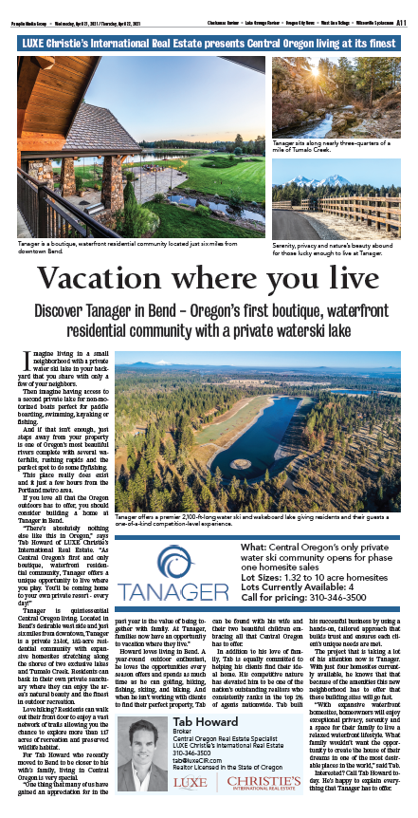
Best Multi-Color Merch Ad
Ad Group A-B
3rd Place
Lake Oswego Review

Slide 33
Best Multi-Color Merch Ad
Ad Group A-B
2nd Place
Columbia Gorge News

Slide 34
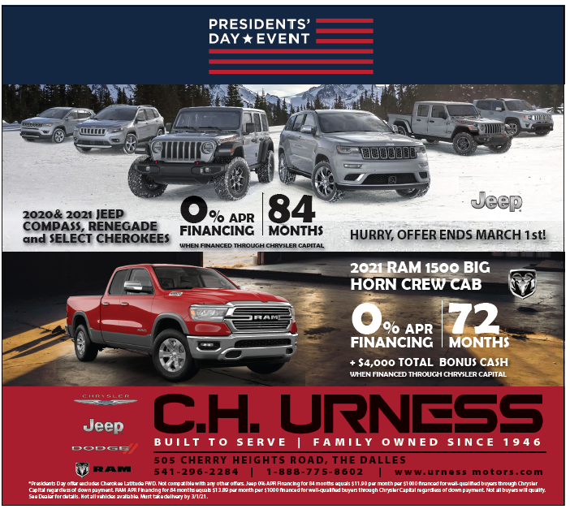
Best Multi-Color Merch Ad
Ad Group A-B
1st Place
Columbia Gorge News

Slide 35
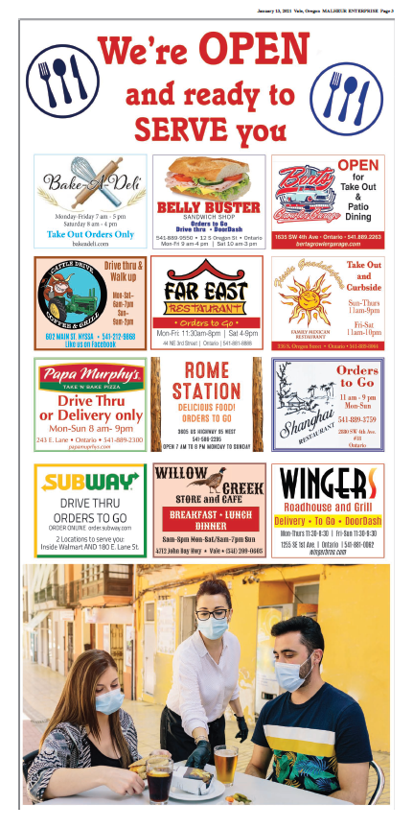
Best Multi-Sponsor ROP Ads
Ad Group D
3rd Place
Malheur Enterprise

Slide 36
Best Multi-Sponsor ROP Ads
Ad Group D
2nd Place
Malheur Enterprise

Slide 37
Best Multi-Sponsor ROP Ads
Ad Group D
1st Place
Malheur Enterprise

Slide 38
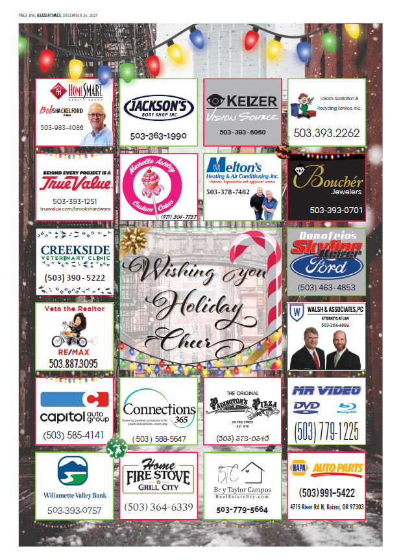
Best Multi-Sponsor ROP Ads
Ad Group C
3rd Place
Keizertimes

Slide 39
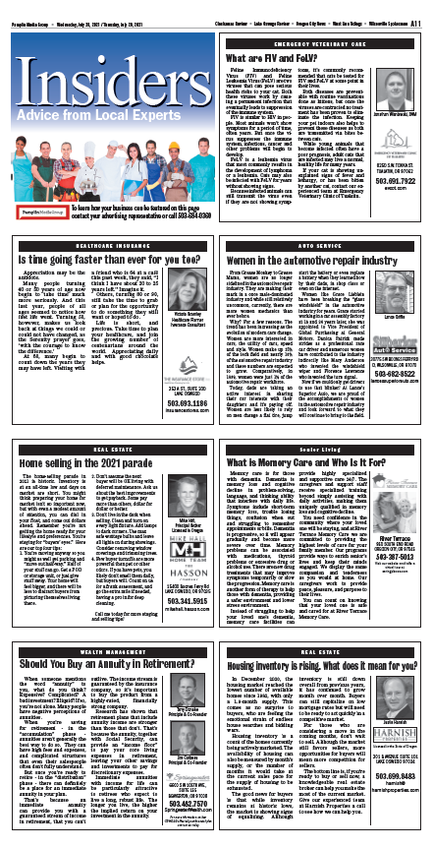
Best Multi-Sponsor ROP Ads
Ad Group C
2nd Place
West Linn Tidings

Slide 40
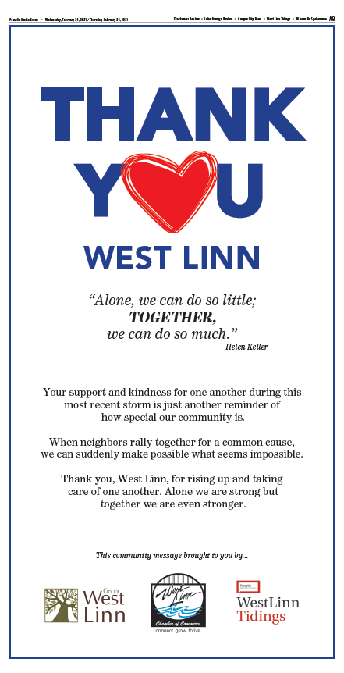
Best Multi-Sponsor ROP Ads
Ad Group C
1st Place
West Linn Tidings

Slide 41
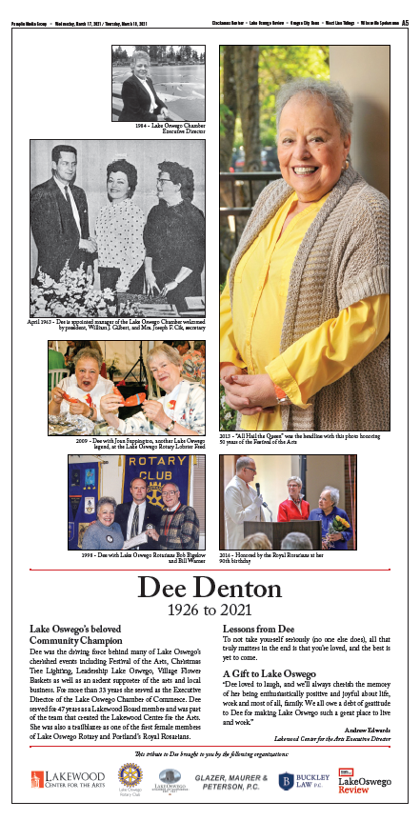
Best Multi-Sponsor ROP Ads
Ad Group A-B
3rd Place
Lake Oswego Review

Slide 42
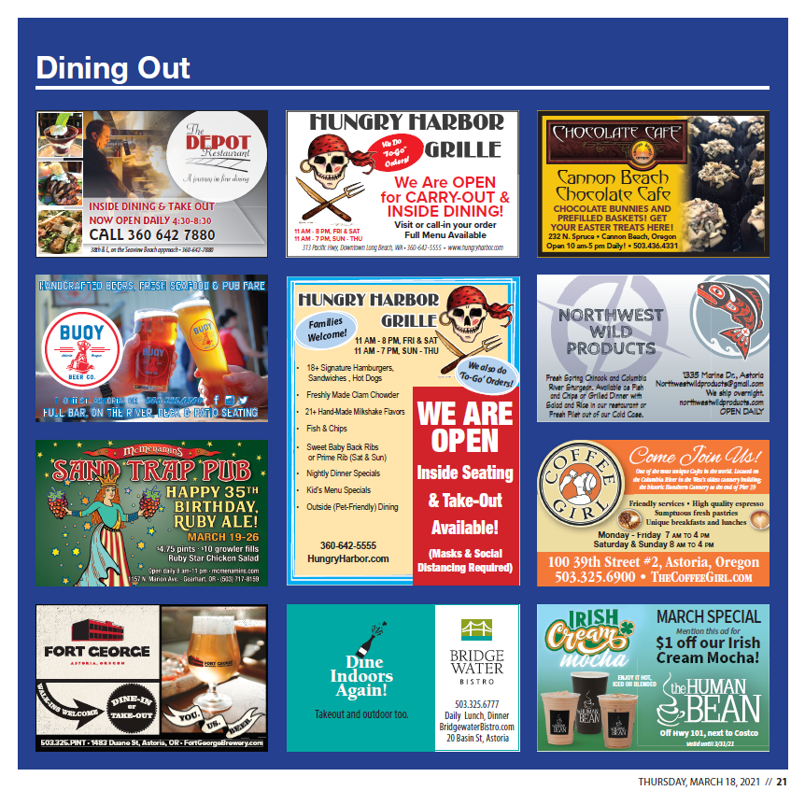
Best Multi-Sponsor ROP Ads
Ad Group A-B
2nd Place
Astoria Daily Astorian

Slide 43
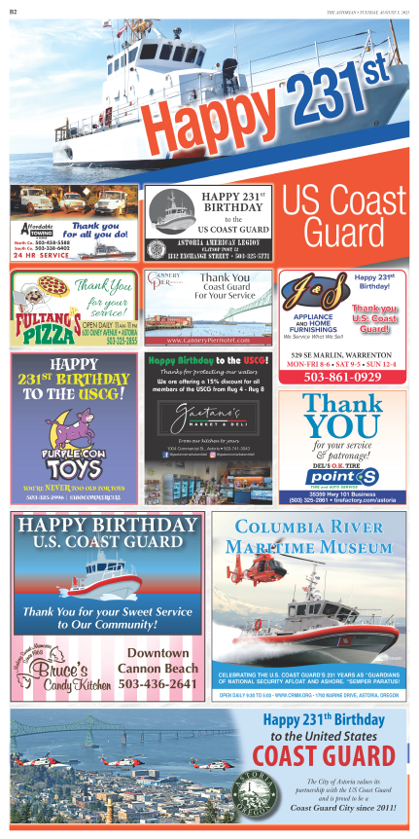
Best Multi-Sponsor ROP Ads
Ad Group A-B
1st Place
Astoria Daily Astorian

Slide 44
Best Overall Advertising (non-dailies)
Ad Group A-D
3rd Place
Astoria Daily Astorian

Slide 45
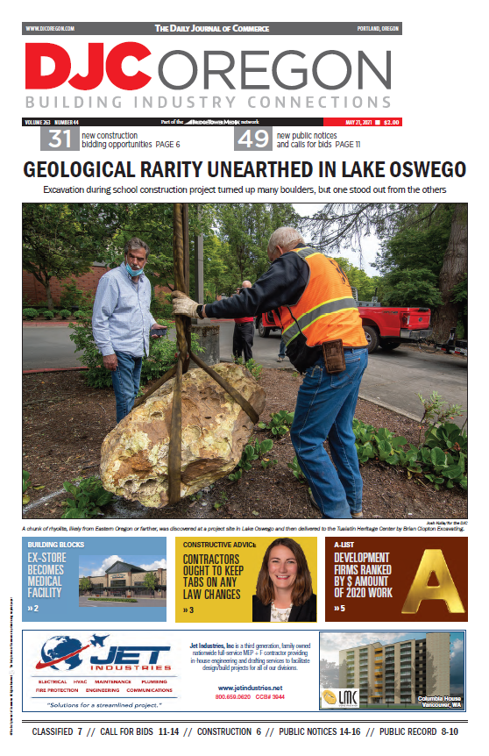
Best Overall Advertising (non-dailies)
Ad Group A-D
2nd Place
Portland Daily Journal of Commerce

Slide 46
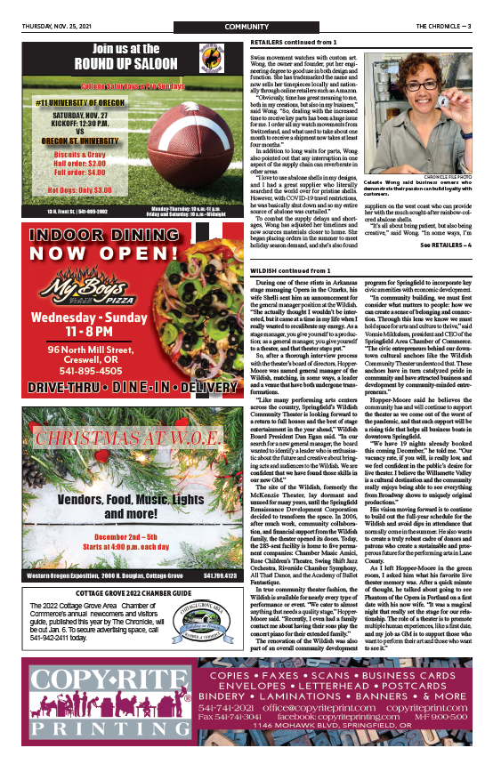
Best Overall Advertising (non-dailies)
Ad Group A-D
1st Place
Creswell Chronicle

Slide 47
Best Series
Ad Group A-D
3rd Place
Astoria Daily Astorian

Slide 48
Best Series
Ad Group A-D
2nd Place
Creswell Chronicle

Slide 49
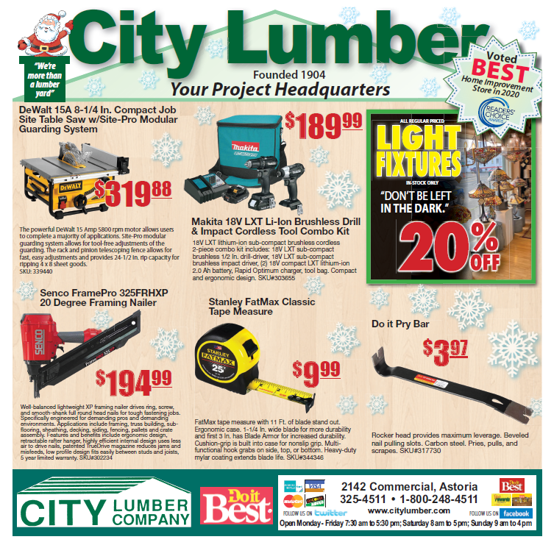
Best Series
Ad Group A-D
1st Place
Astoria Daily Astorian

Slide 50
Best Single House Ad
Ad Group C-D
3rd Place
Keizertimes

Slide 51
Best Single House Ad
Ad Group C-D
2nd Place
Malheur Enterprise

Slide 52
Best Single House Ad
Ad Group C-D
1st Place
Keizertimes

Slide 53
Best Single House Ad
Ad Group A-B
3rd Place
Lake Oswego Review

Slide 54
Best Single House Ad
Ad Group A-B
2nd Place
Lake Oswego Review

Slide 55
Best Single House Ad
Ad Group A-B
1st Place
Astoria Daily Astorian

Slide 56
Best Section Cover
Ad Group C-D
3rd Place
Redmond Spokesman

Slide 57
Best Section Cover
Ad Group C-D
2nd Place
The New Era

Slide 58
Best Section Cover
Ad Group C-D
1st Place
Redmond Spokesman

Slide 59
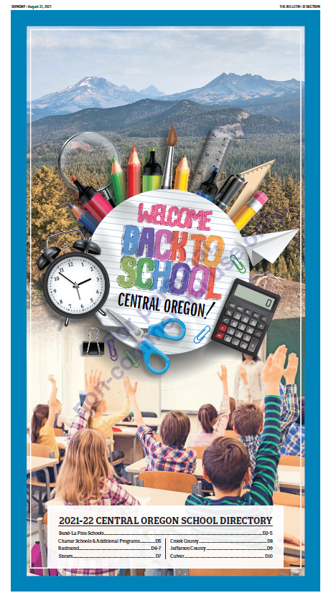
Best Section Cover
Ad Group A-B
3rd Place
Bend Bulletin

Slide 60
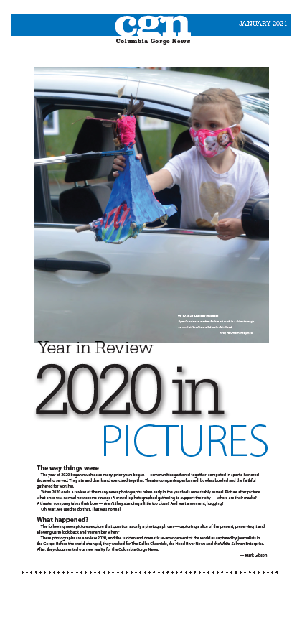
Best Section Cover
Ad Group A-B
2nd Place
Columbia Gorge News

Slide 61
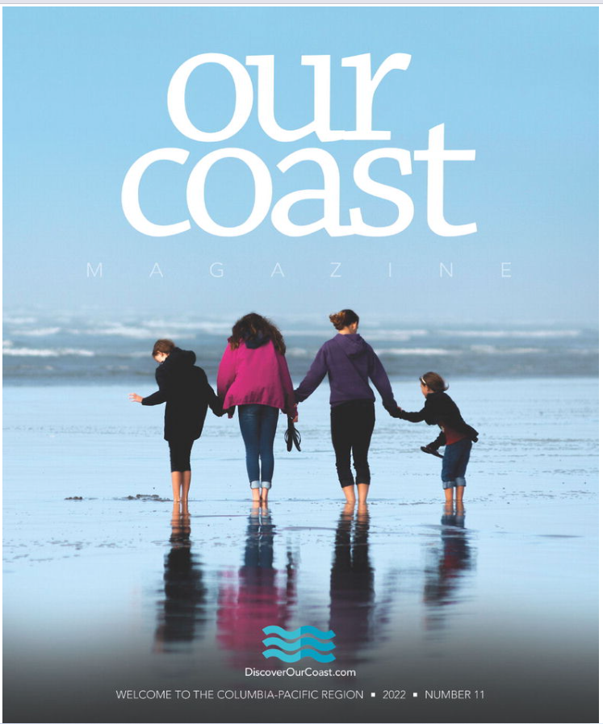
Best Section Cover
Ad Group A-B
1st Place
Astoria Daily Astorian

Slide 62
Best Use of One Color and Black
Ad Group A-D
3rd Place
Keizertimes

Slide 63
Best Use of One Color and Black
Ad Group A-D
2nd Place
Creswell Chronicle

Slide 64
Best Use of One Color and Black
Ad Group A-D
1st Place
Malheur Enterprise

Slide 65
Most Effective Use of Small Space
Ad Group A-D
3rd Place
Creswell Chronicle

Slide 66
Most Effective Use of Small Space
Ad Group A-D
2nd Place
Keizertimes

Slide 67
Most Effective Use of Small Space
Ad Group A-D
1st Place
Keizertimes

Slide 68
Congratulations to all our winners and thank you for participating in the 2022 Best Ad Ideas Contest

Slide 69
Christine Moore Advertising Executive of the Year Award

